Slide 1

Everyday Magic

Slide 2
Proverbs 18:21
Death and life are in the power of the tongue …

Slide 3
Words of Creation
God said let there be ____ and then there was:
  Light; Sky; Land; Vegetation; Stars; Animals; Man; etc.
God blessed the living creatures and they were fruitful. God blessed man, and he was given dominion.

Slide 4
James 3:5-10 (sel)
So also the tongue is a small member, yet it boasts of great things. How great a forest is set ablaze by such a small fire! And the tongue is a fire, a world of unrighteousness.
The tongue is set among our members, staining the whole body, setting on fire the entire course of life, and set on fire by hell … no one can tame the tongue. It is a restless evil, full of deadly poison. With it we bless our Lord and Father, and with it we curse people who are made in the likeness of God.
From the same mouth come blessing and cursing. My brothers, these things ought not to be so.

Slide 5
Proverbs
12:18 - There is one whose rash words are like sword thrusts, but the tongue of the wise brings healing.
15:4 - A gentle tongue is a tree of life …
16:24 - Gracious words are a honeycomb, sweet to the soul and healing to the bones.
107:20 - He sent out His word and healed them, and delivered them from their destruction.

Slide 6

For no good tree bears bad fruit, nor again does a bad tree bear good fruit, for each tree is known by its own fruit. For figs are not gathered from thornbushes, nor are grapes picked from a bramble bush. The good person out of the
good treasure of his heart produces good, and the evil person out of his evil treasure produces evil, for out of the abundance of the heart his mouth speaks. - Lk 6:43-45

Slide 7
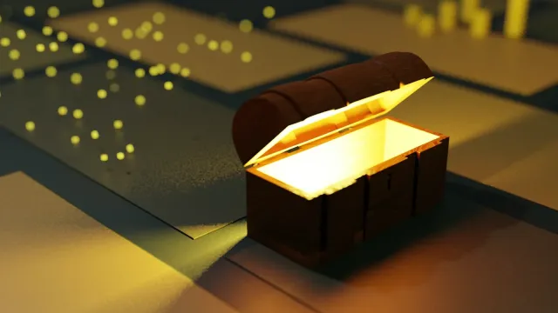

Slide 8
Ephesians 4
4:15 … speaking the truth in love, we are to grow up in every way into him who is the head, into Christ.
4:25-29 - …put away falsehood, let each one of you speak the truth with his neighbor… Be angry and do not sin; do not let the sun go down on your anger, and give no opportunity to the devil … Let no corrupting talk come out of your mouths, but only such as is good for building up, as fits the occasion, that it may give grace to those who hear.

Slide 9
Is it what I’m about to say:
Helpful?
3
Does what I’m about to say: Buildup?
2
Is it what I’m about to say:
Wholesome?
1

Slide 10
Colossians 4:5-6
Walk in wisdom toward outsiders, making the best use of the time.
Let your speech always be gracious, seasoned with salt, so that you may know how you ought to answer each person.

Slide 11
Romans 12
Let love be genuine. Abhor what is evil; hold fast to what is good.
Love one another with brotherly affection. Outdo one another in showing honor. Do not be slothful in zeal, be fervent in spirit, serve the Lord. Rejoice in hope, be patient in tribulation, be constant in prayer. Contribute to the needs of the saints and seek to show hospitality.
Bless those who persecute you; bless and do not curse them. Rejoice with those who rejoice, weep with those who weep. Live in harmony with one another. Do not be haughty, but associate with the lowly. Never be wise in your own sight.
Repay no one evil for evil, but give thought to do what is honorable in the sight of all. If possible, so far as it depends on you, live peaceably with all.
Beloved, never avenge yourselves, but leave it to the wrath of God, for it is written, “Vengeance is mine, I will repay, says the Lord.”
To the contrary, “if your enemy is hungry, feed him; if he is thirsty, give him something to drink; for by so doing you will heap burning coals on his head.”
Do not be overcome by evil, but overcome evil with good.

Slide 12
Everyday Magic

