Slide 1
“The Gerasene Demoniac Set Free”
Luke 8:26-39
(Mt. 8:28-34; Mk. 5:1-20)
This is a classic case of demon possession (8:26-29).
Jesus casts out the demons (8:30-33).
The reaction of the people (8:34-37).
The reaction of the delivered man (8:38-39).

Slide 2
This is a classic case of demon possession (8:26-29).
  Intro: “Demon possession” is a topic which prompts a variety of responses in people, from curiosity to great fear. Most of us probably have to admit our limited knowledge in this area. We will do the best we can by limiting our speculation and staying close to the biblical record. We have a considerable record at hand today with regard to the Gerasene demoniac (Cp. “Gadarene demoniacs” pl. in Mt. 8:28). Here is a classic case of demon possession with men utterly helpless to do anything about it (Lk. 8:26-30) but Jesus was able to cast out the demons (Lk. 8:33). As it turned out, the majority of the people preferred that Jesus would never have come in the first place (Lk. 8:37). The

Slide 3
  (cont.) one exception to this would be the former demoniac himself. Not only was he thrilled to have been set free from demon possession but now he wanted to go forward and join the ministry team and be a witness for Christ. He was not permitted to join the ministry team, but he went away, as Jesus had instructed him, “proclaiming throughout the whole city what great things Jesus had done for him.”
  (vs. 26) Jesus and the disciples had completed their journey to the west side of the lake which included the storm that they survived (Lk. 8:22-25). Now they have “sailed” back in the opposite direction to the east side of the lake & the “country of the Gerasenes,” “which is

Slide 4
  (cont.) opposite Galilee.” BK says, “What is meant by the region of the Gerasenes? Apparently, the area was named for the small town Gersa (now the ruins of Khersa) on the eastern shore.” Again, BK says, “Matthew mentioned ‘the region of the Gadarenes’ (Matt. 8:28), which was named for the town Gadara, about six miles southeast of the lower tip of the Sea of Galilee. Perhaps the territory around Gersa belonged to the city of Gadara (cf. comments on Mk. 5:1).” Again, BK says, “Greek manuscripts are divided on the precise location involved, citing three names: Gadarenes (Matt. 8:28), Gergesenes (from Origen), and Gerasenes.” See maps. There were several other towns of similar sounding names in the district of the Decapolis,

Slide 5
  (cont.) meaning ten cities (cf. vs. 20). These cities were Gerasa, Gadara, Gersa, modern Khersa, “Gersa” BK p. 122 but ATR, p. 69 calls it “Gerasa” and if correct there were possibly two cities with that same name. The small town Gersa (fr. which is derived Gerasenes) would have been included in the country of the Gadarenes (Mt. 8:28) the boundaries of Gadara have been extended all the way NW 6 miles to the shore of the lake of Galilee this was a region of Gentiles as is clear from the reference to swine in Mk. 5:11 which would not have been grazing in a Jewish setting (Lev. 11:7-8).
    It is interesting that Mk. 5:20 has the term, “‘Decapolis’ (‘Ten Cities’), a region east and southeast of the Sea of

Slide 6
    Galilee, north of Perea, and belonging to the half-tribe of Manasseh. It was so named for the ten cities that lay within its borders. The names of those cities are not certain. Pliny lists them as Scythopolis, Philadelphia, Raphanae, Gadara, Hippos, Dios, Pella, Gerasa, Canatha, and Damascus. Josephus replaces Canatha with Otopos on his list. Of the ten cities, only one, the capital Scythopolis, lay west of the Jordan River. Jesus visited the region of Decapolis during His ministry. Mt. (8:28) calls it ‘the country of the Gadarenes,’ because Jesus was near Gadara.”

Slide 7
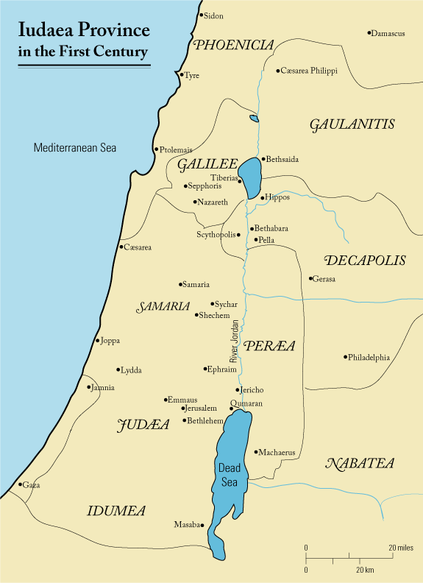
First century Iudaea province - Perea - Wikipedia

Slide 8
  (vs. 27) Rather than finding rest on the other side, a demon possessed man presented himself; Mark says it happened immediately. Matthew says there were “two men who were demon-possessed (who) met Him as they were coming out of the tombs. They were so extremely violent that no one could pass by that way.” For “demon possession,” Mark uses the expression “unclean spirit.” It is quite a curiosity, but we do not know how he came to be possessed. Are people who are demon possessed culpable, that is, blameworthy for their condition? Did they somehow allow the demon to enter? In Scripture, they are generally viewed as helpless victims of demonic activity who would love to be delivered from such awful

Slide 9
  (vs. 27) possession and oppression. But there seems to be some support for the notion of personal responsibility in Mt. 12:43-45 where a demon returns to his former house and “finds it unoccupied, swept, and put in order. Then it goes and takes along with it seven other spirits more wicked than itself, and they go in and live there; and the last state of that man becomes worse than the first” (Mt. 12:44b-45a). But nevertheless, notice the sad state of this man before us. First, he was “possessed with demons (ἔχων δαιμόνια),” plural, literally, “having demons,” but in reality, they had him. “And” as a result he was one “who had not put on any clothing for a long time, and” further, he, “was not living in a house, but in the tombs.”

Slide 10
  (vs. 28) “Seeing Jesus,” it seems that the demon possessed man felt fearful and threatened. So, “he cried out and fell before Him,” probably in fear, showing that he recognized the superiority of Jesus, “and said in a loud voice, ‘What business do we have with each other, Jesus, Son of the Most High God? I beg You, do not torment me.’” Mt. 8:29 puts this in the form of a question, “Have You come here to torment us before the time?” The demons in this man knew that they had a problem upon Jesus’ arrival, so, they literally asked, “Τί ἐμοὶ καὶ σοί,” “what to me and to you?” or “What do I have to do with you?” or “What do you want with me?” (NIV84). The question means something like, “What do we have in common?” The answer is,

Slide 11
  (cont.) “nothing,” as 2Cor. 6:15 makes clear with its rhetorical question, “Or what harmony has Christ with Belial.” But the demons do accurately identify “Jesus,” calling him by name with the precise title “Son of the Most High God.” Speaking as one, they filed the request that Jesus not torment or torture them before the time. “Matthew is the one who adds that they said, “before the time,” an apparent reference to the future judgment of fallen angels which they knew was coming (1Cor. 6:3; Rv. 20:1-3, 10) and which was sealed at the cross (Heb. 2:14; cf. Col. 2:15).
  (vs. 29) This is the explanation for the outcry of the demons in vs. 28, “For He had commanded the unclean spirit to come out of the man.” It seems that the demons

Slide 12
  (cont.) were resisting Jesus’ command to come out. This explanation probably covers several weeks or months: “For it had seized him many times; and he was bound with chains and shackles and kept under guard, and yet he would break his bonds and be driven by the demon into the desert.” “Certain effects of demon possession cited in this passage are (1) disregard for personal dignity (nakedness), (2) social isolation, (3) retreat to the simplest kind of shelter (caves, often containing tombs, were also used for shelter by the very poor), (4) demons’ recognition of Jesus’ deity, (5) demonic control of speech, (6) shouting, and (7) extraordinary strength.” To this we could add the lack of sleep and self-destruction (Mk. 5:5).

Slide 13
Jesus casts out the demons (8:30-33).
  (vs. 30) We really do not know why Jesus asked what his name was. One reason might be that in this way the observers would understand better what was going on with this man. By revealing that his name was “Legion for we are many,” it became clear that here was a man under the force of multiple demonic powers. No wonder his condition was so desperate. A legion in the Roman army stood for approximately 6,000 soldiers and the word then came to mean “many” in some contexts, as perhaps here.
  (vs. 31) The demons were speaking to Jesus and “imploring Him not to command them to go away into the abyss.” There are scholars, Dr. Sellers for one, who hold

Slide 14
  (cont.) that when a demon is expelled from a man after possessing him, that potentially he can be cast into the abyss, a place of torment (Lk. 8:31; cp. 2Pt. 2:4; Jude 6 in connection with Gen. 6:1-4). Ryrie says the abyss is, “The place to which all evil spirits will ultimately be consigned (Rev. 9:1; 20:1, 3).” That is the demons’ real fear here, not completely clear in Mark’s euphemistic, “out of the country” (Mk. 5:10). The fact that they were aware of the awful judgment that awaited them would explain the manner of their plea with the words “implore (παρακαλέω)” and “earnestly (πολύς)” (Mk. 5:10).”
  (vv. 32-33) “Now there was a herd of many swine feeding there on the mountain; and the demons implored Him to
Notes:
Mk. 5:13 says, “Jesus gave them permission. And coming out, the unclean spirits entered the swine; and the herd rushed down the steep bank into the sea, about two thousand of them; and they were drowned in the sea.”
(La Habra, CA: The Lockman Foundation, 1995), Mk 5:13.
New American Standard Bible: 1995 Update (La Habra, CA: The Lockman Foundation, 1995), Mk 5:13.

Slide 15
  (cont.) permit them to enter the swine. And He gave them permission.” Notice that Jesus did not send the demons into the swine. He simply gave them permission to go. And we do not know why He gave permission. But there is no moral issue here regarding the loss of the swine to the herdsmen. Ultimately all things are God’s to do with as He pleases. As Job said, “The Lord gave and the Lord has taken away. Blessed be the name of the Lord.” Man really does not own anything (1Tim. 6:7). But then why, after being granted permission, did the demons drive the hogs down to be drowned in the sea? Perhaps they knew that this was the one thing they could do to bring disfavor from the people upon Jesus. And it worked. But where did the

Slide 16
  (cont.) demons go after this? We do not know. I am inclined to believe that they are now in the abyss (cf. Mk. 5:6-7).

Slide 17
The reaction of the people (8:34-37).
  (vs. 34) An event of this magnitude will garner a lot of attention. Thousands of demons had entered thousands of pigs and caused them to drown in the sea! “Both you in the city and in the country, ‘Come and see for yourselves!’” the swine herders must have yelled.
  (vs. 35) The man who formerly terrified them as implied in Mt. 8:28, they found, “sitting down at the feet of Jesus, clothed and in his right mind.” What a blessing! No? Instead, “they became frightened.” “And all the people of the country of the Gerasenes and the surrounding district asked Him to leave them” (Lk. 8:37). Instead of a blessing, they saw it as damage and loss. So, after they asked Jesus

Slide 18
  (cont.) to leave their region, He complied with their request, “and He got into a boat and returned.””

Slide 19
The reaction of the delivered man (8:38-39).
  (vs. 38) It is inconceivable how there could be a more beautiful response to this deliverance than what is recorded here, and please notice the tragic contrast to the others in vs. 37. “As Jesus was getting into the boat to leave, the man who had been demon-possessed was imploring Him that he might accompany Him” (Mk. 5:18). As a rule, if Jesus has done anything for you, you will want to be with Him. But Jesus would not permit it. But it was not that Jesus had nothing for him to do. He had a definite plan for his life. So “He sent him away saying”:
  (vs. 39) “Return to your house and describe what great things God has done for you.” Apparently, his house was
Notes:
“But the man from whom the demons had gone out was begging Him that he might accompany Him; but He sent him away, saying…”
(La Habra, CA: The Lockman Foundation, 1995), Lk 8:38.
New American Standard Bible: 1995 Update (La Habra, CA: The Lockman Foundation, 1995), Lk 8:38.

Slide 20
  (vs. 39) still his house. How long had it been since he was even in it? He now had a ministry to fulfill. He was to describe (διηγοῦ), that is, “to give a detailed account of” all the “great things God has done for” him. That is exactly what he did too: “So he went away, proclaiming (κηρύσσων – ‘to make public declarations, proclaim aloud’ – BDAG 543) throughout the whole city what great things Jesus had done for him.” Finally, Mark tells us, “and everyone was amazed” (Mk. 5:20b).

Slide 21
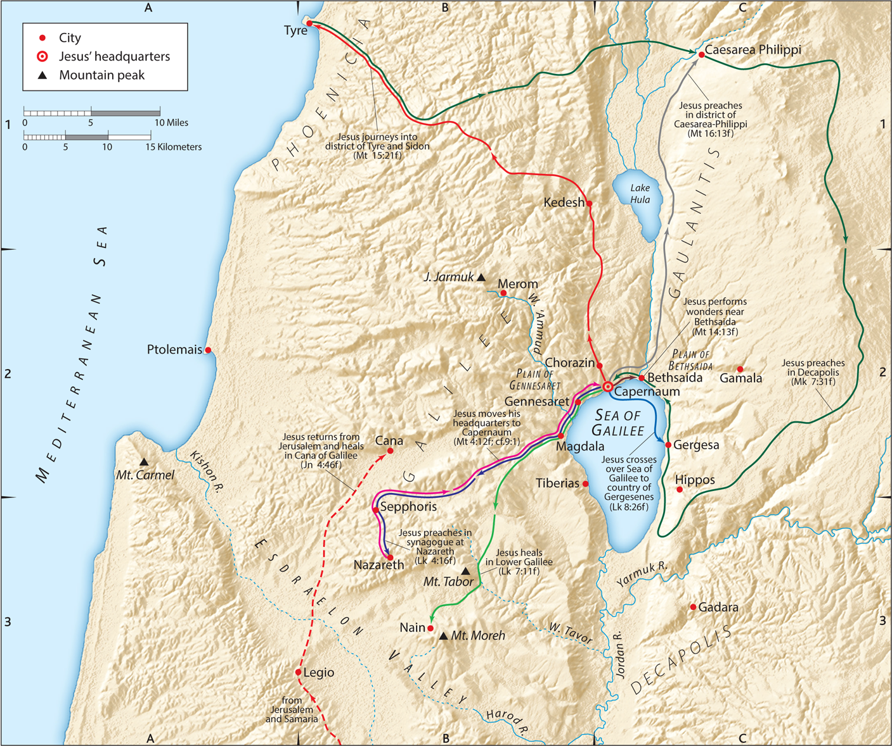

Slide 22
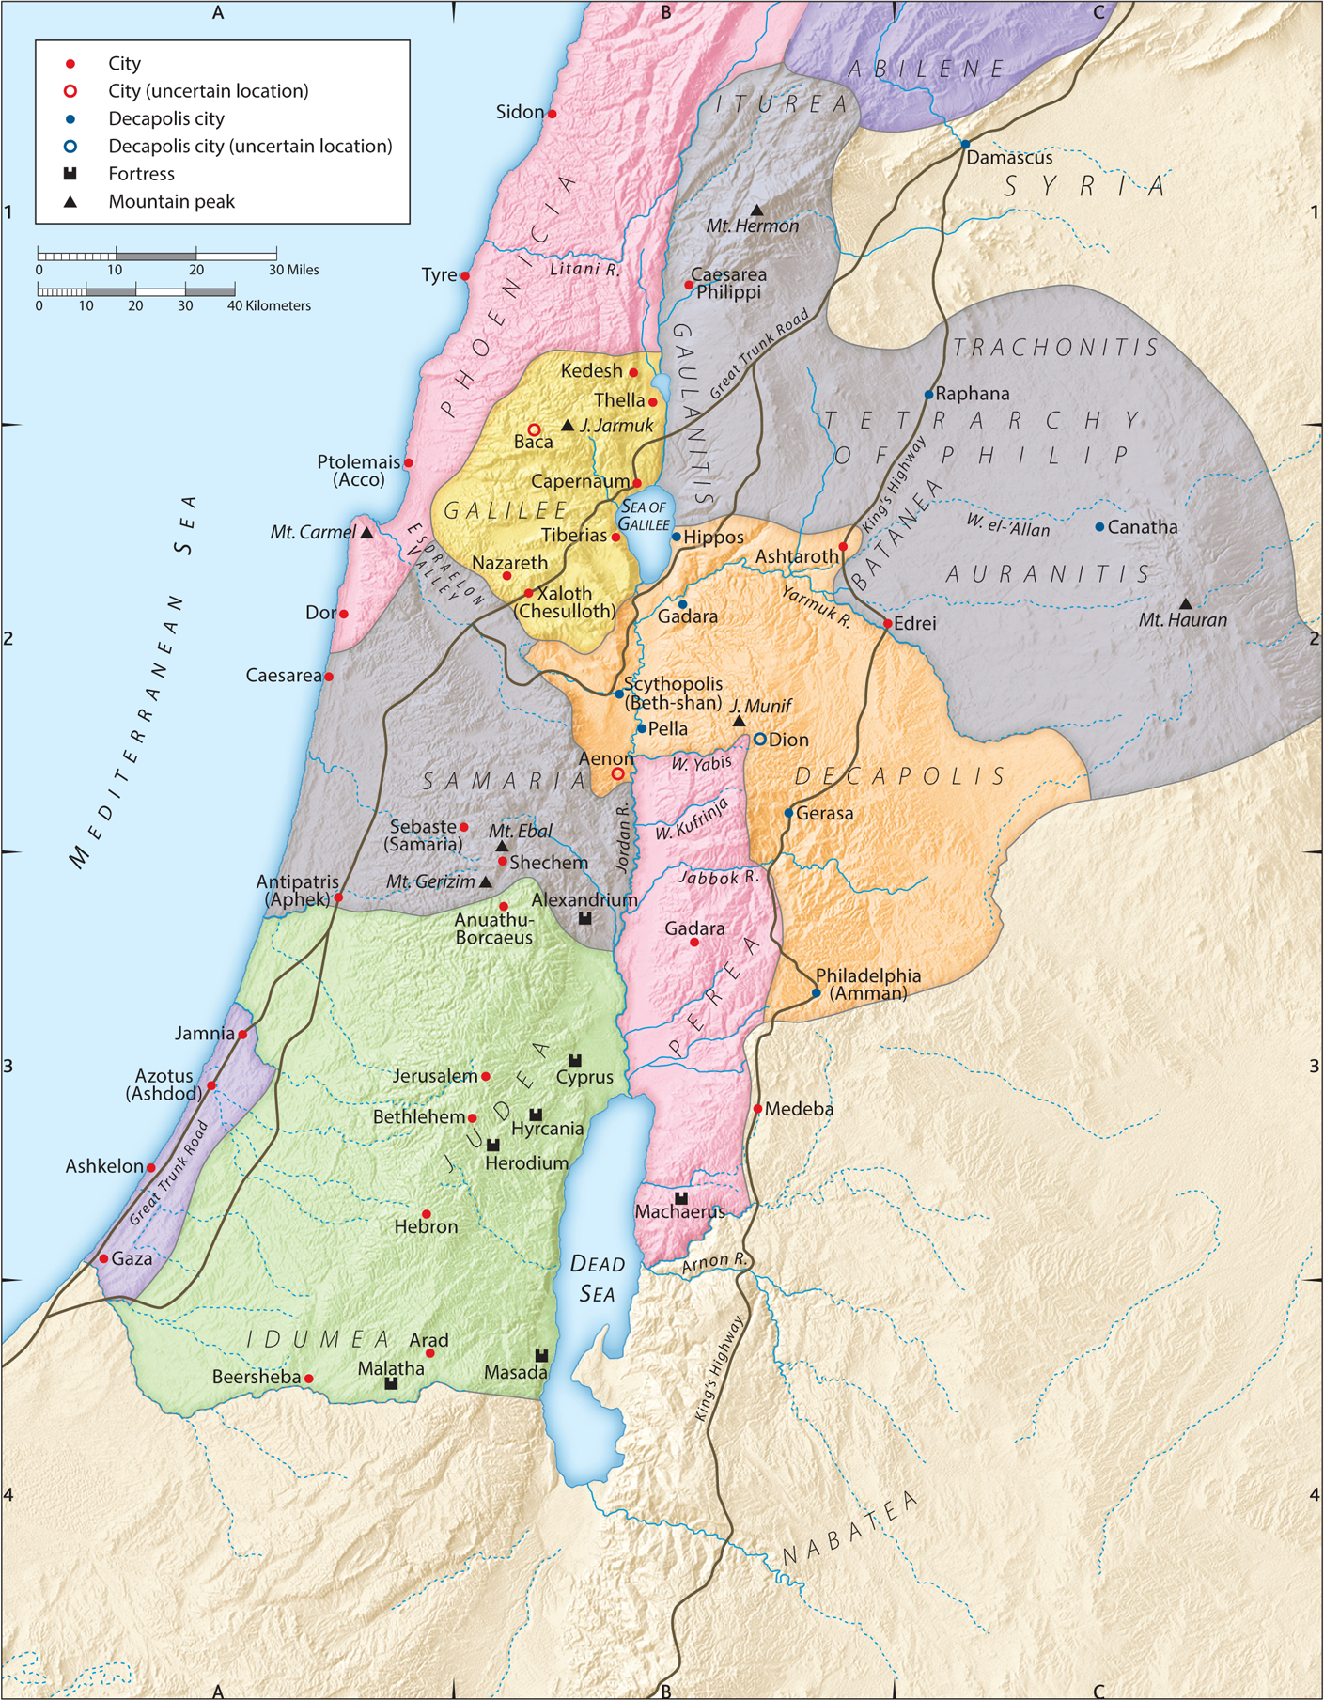

Slide 23
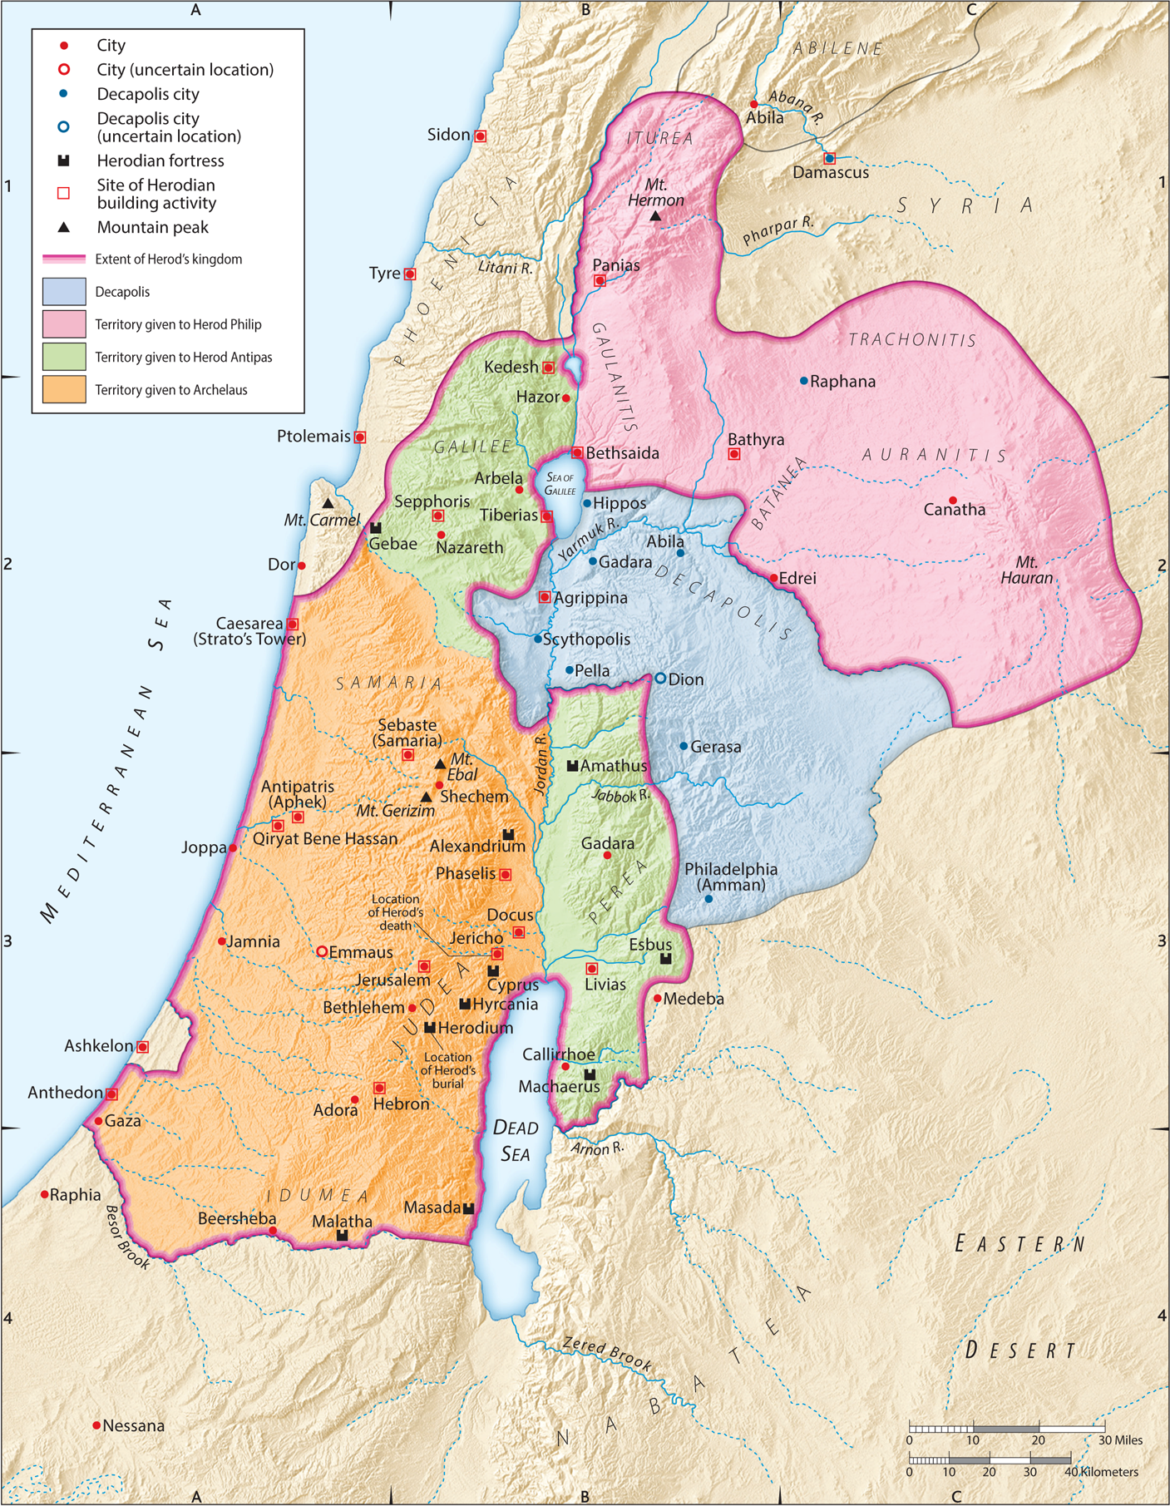

Slide 24
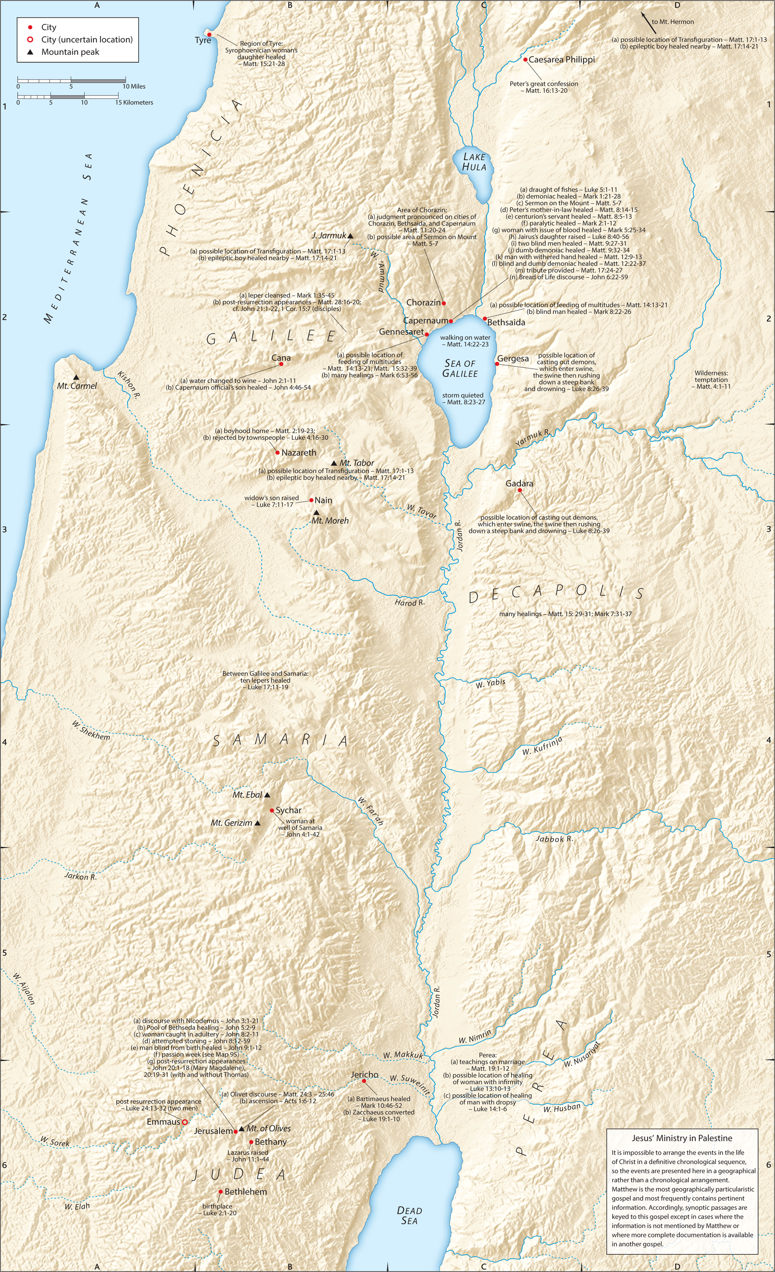

Slide 25
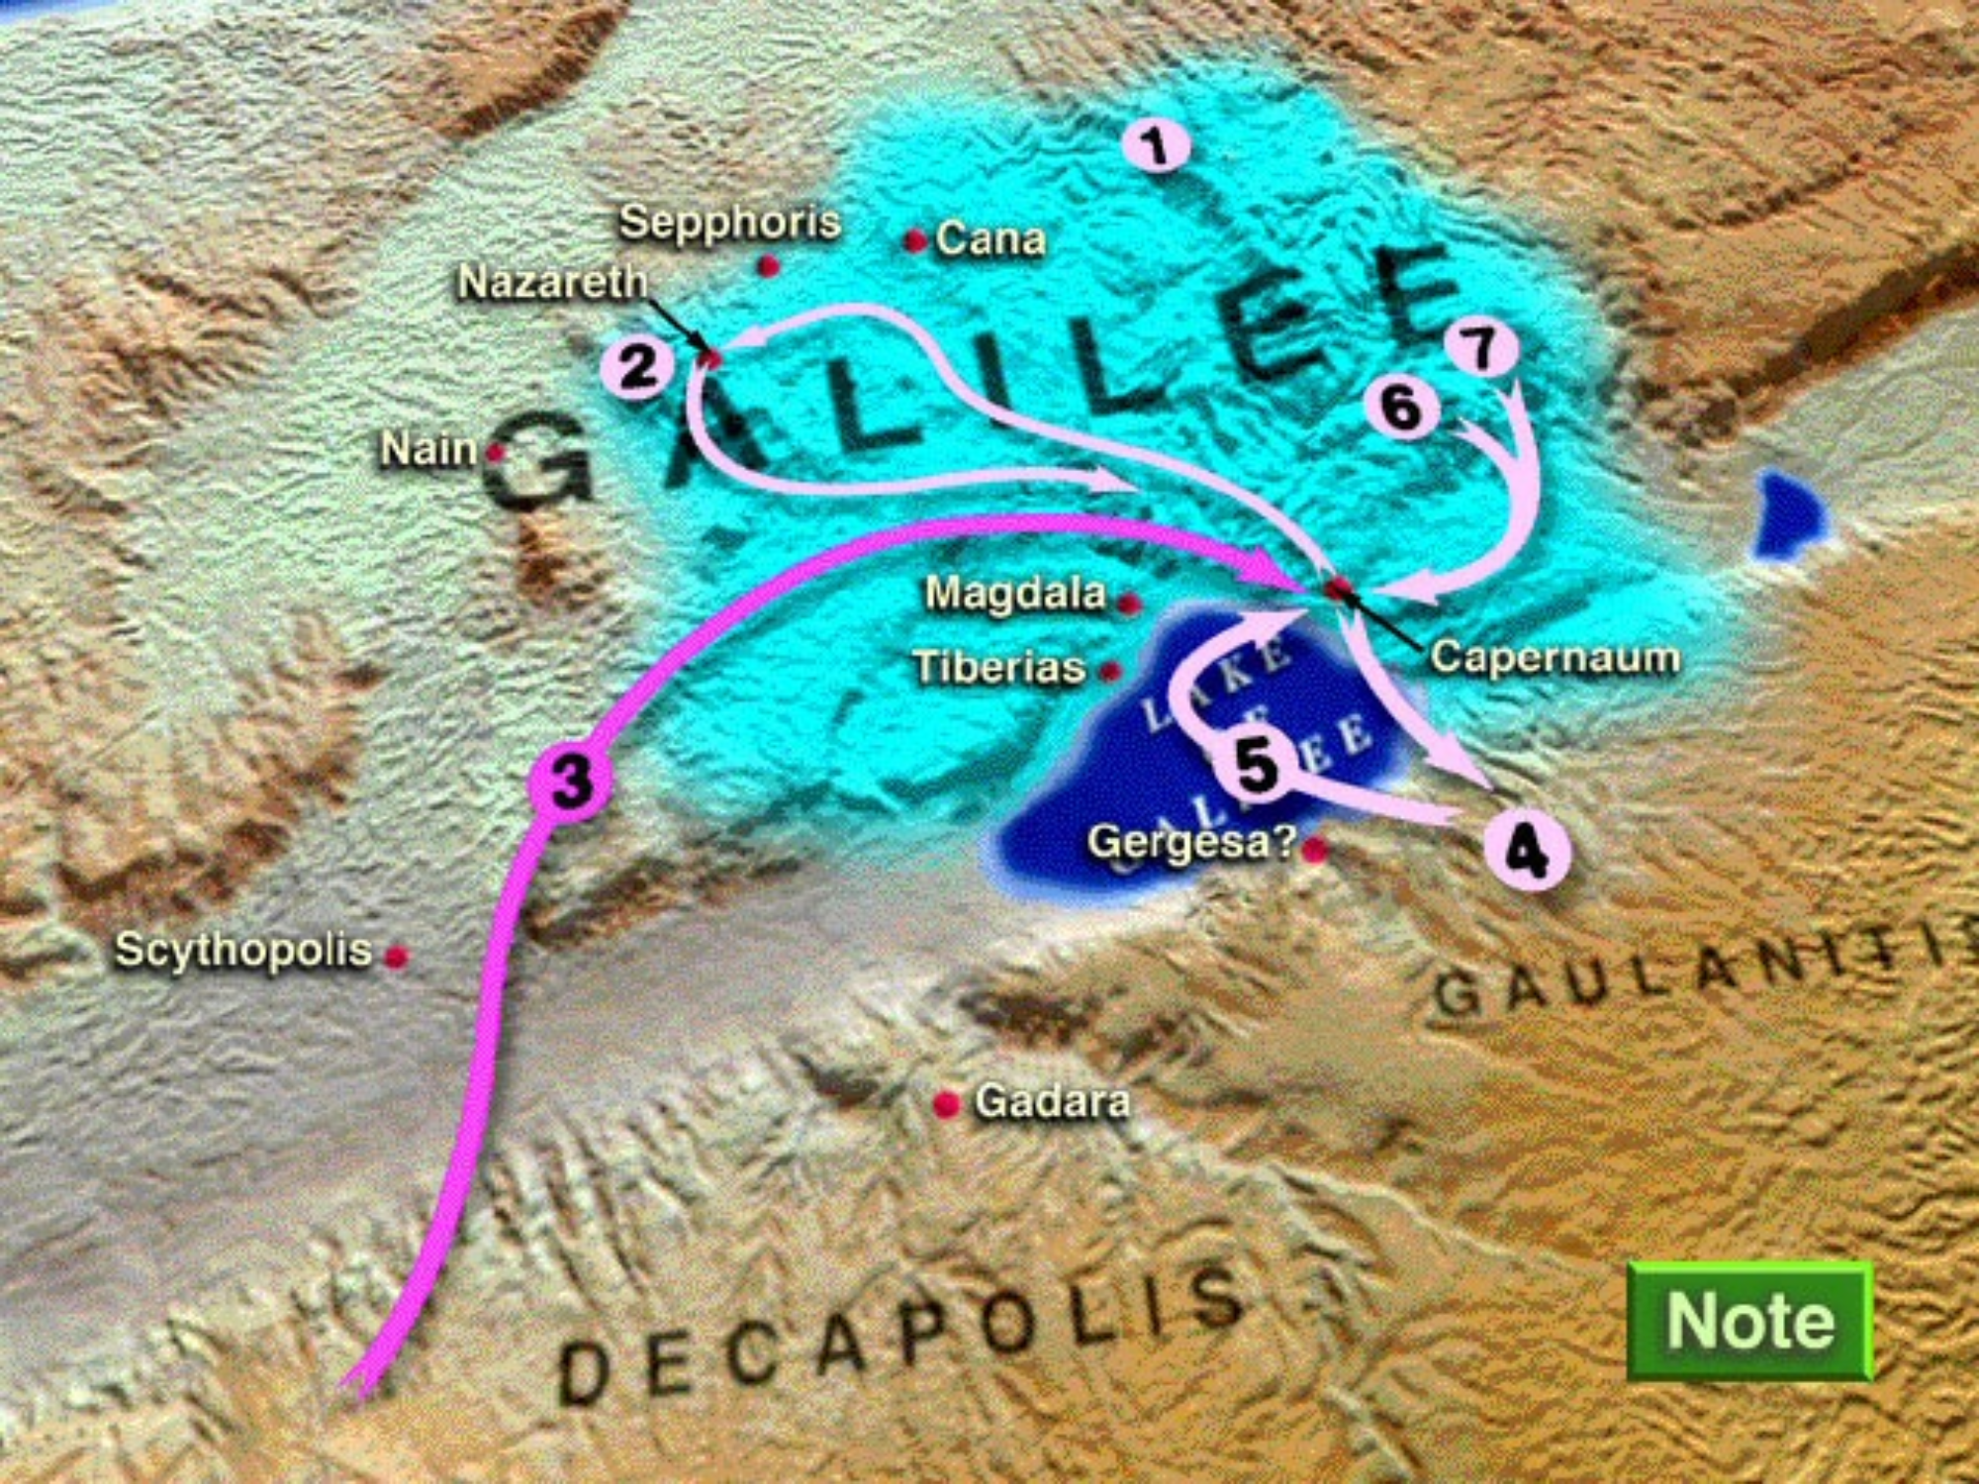

Slide 26
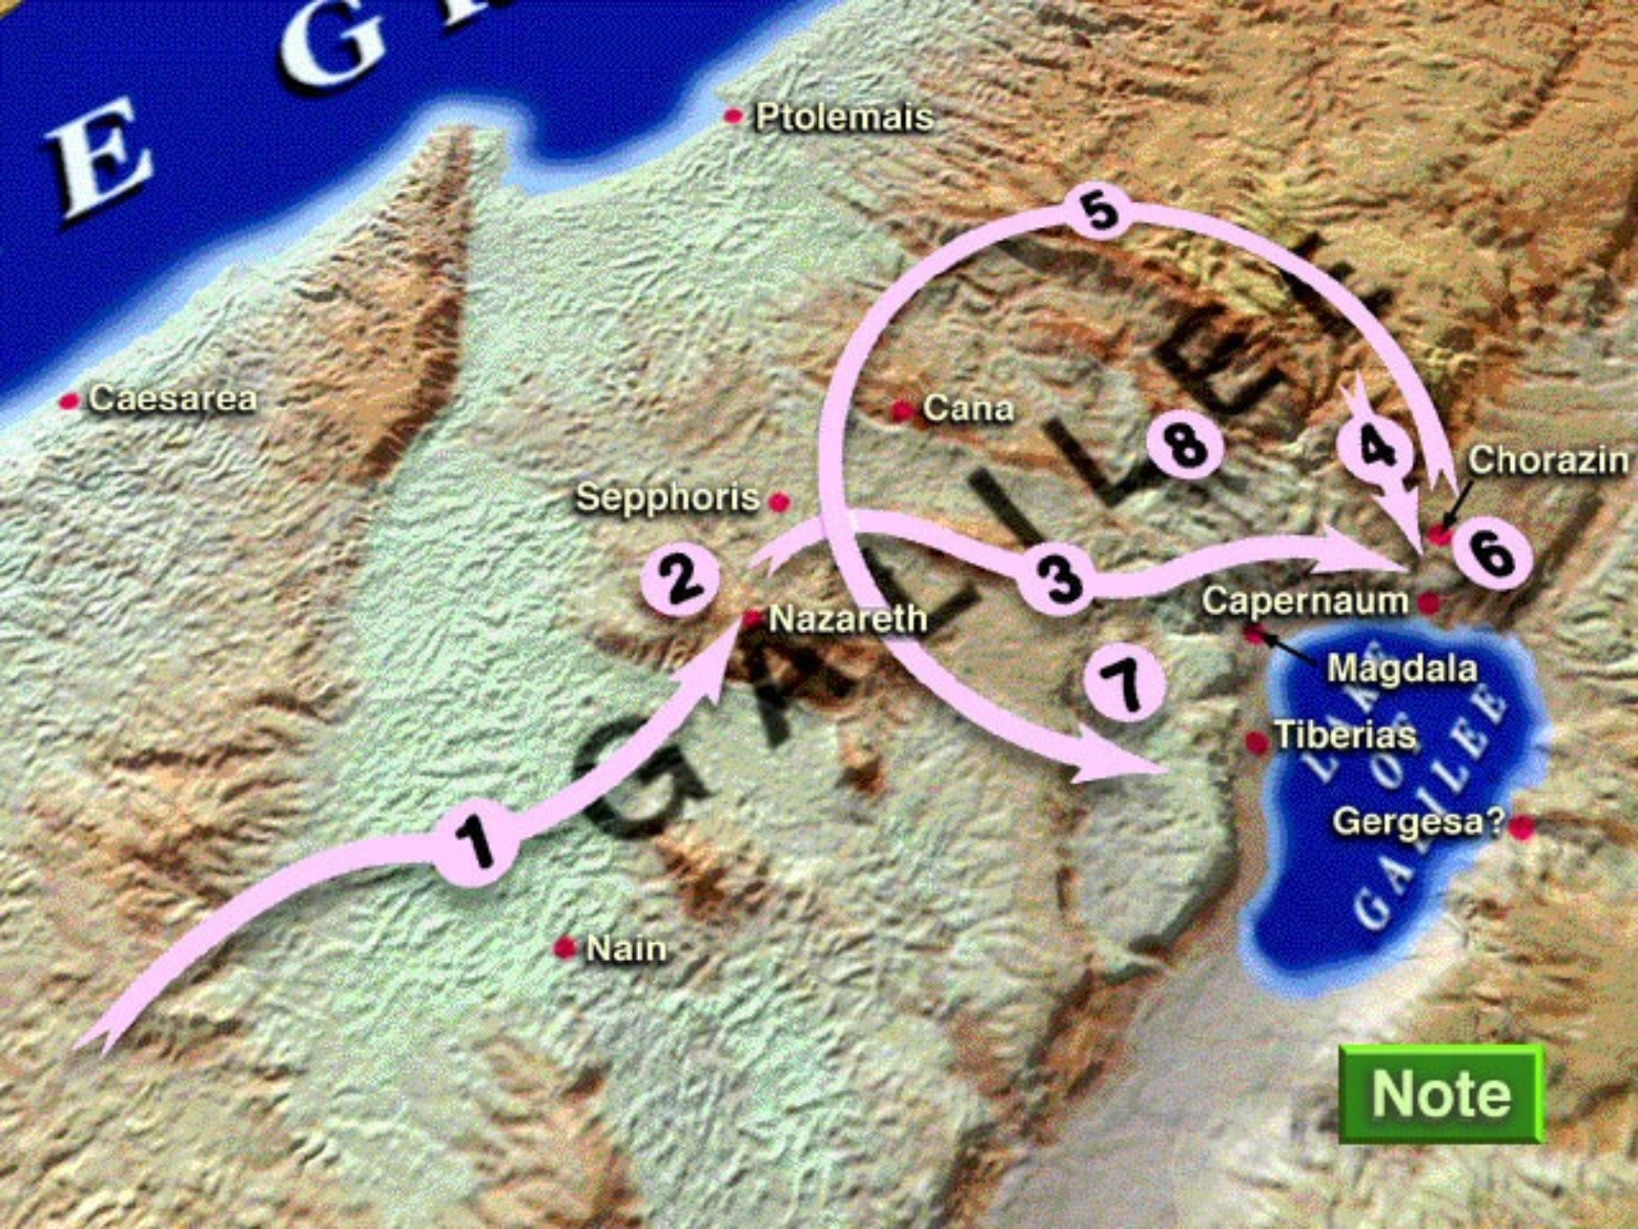

Slide 27
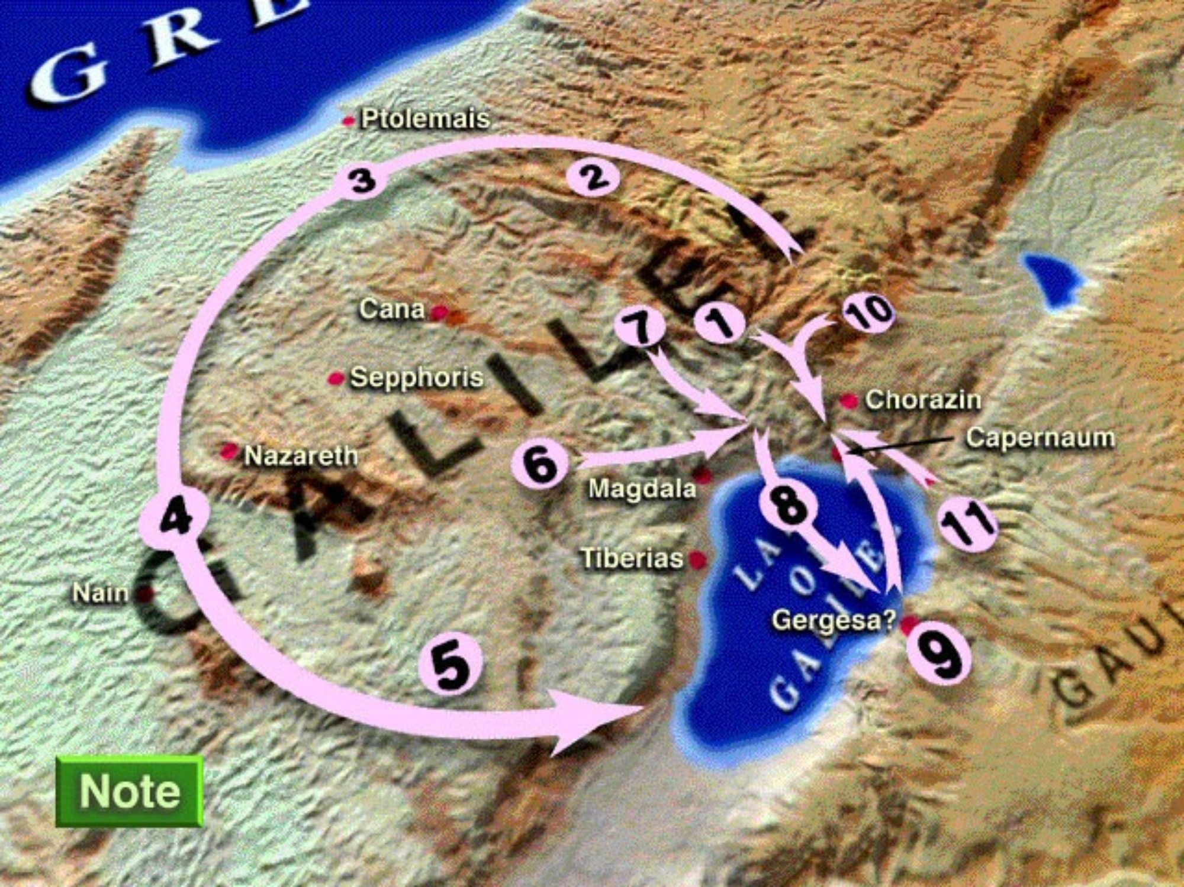

Slide 28
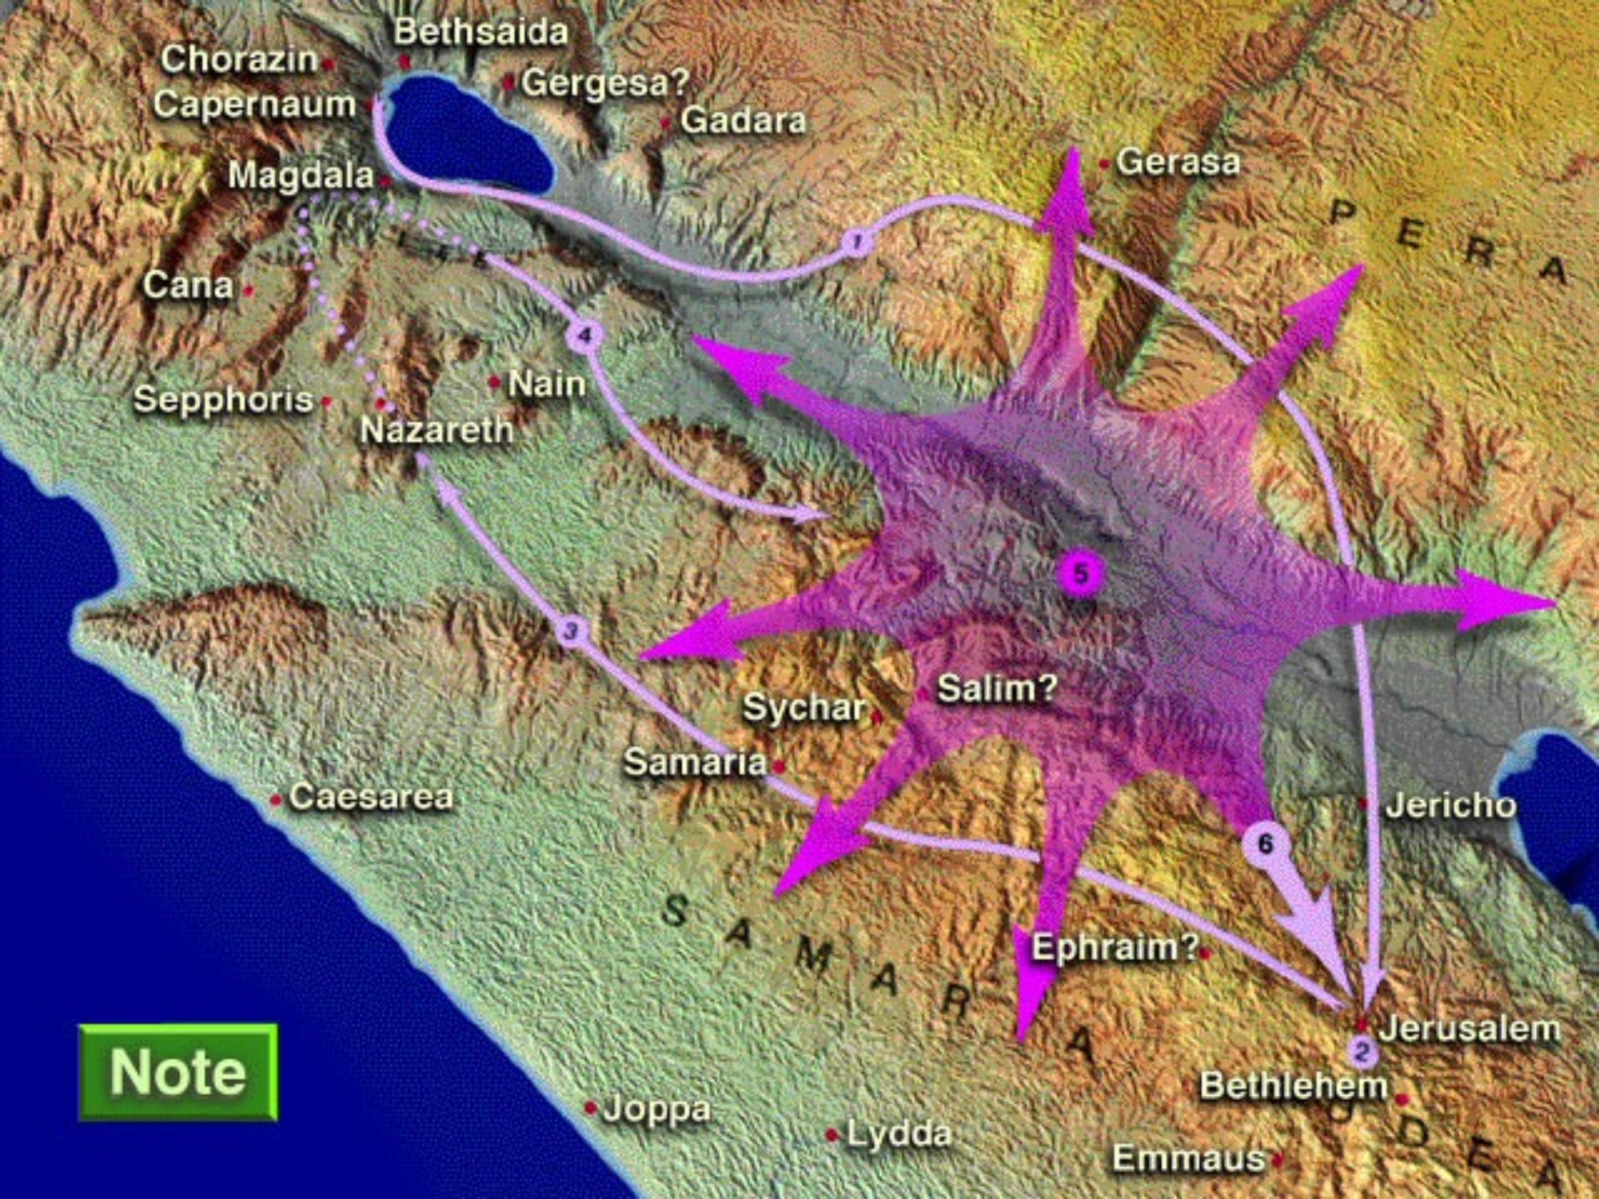

Slide 29
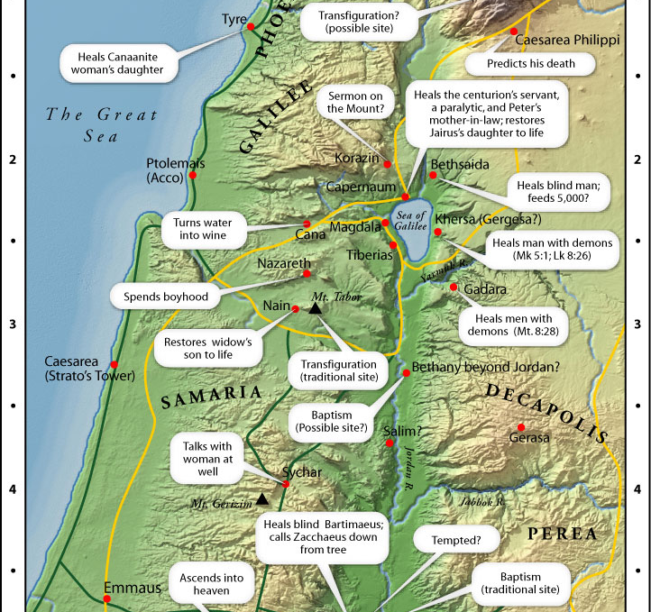

Slide 30
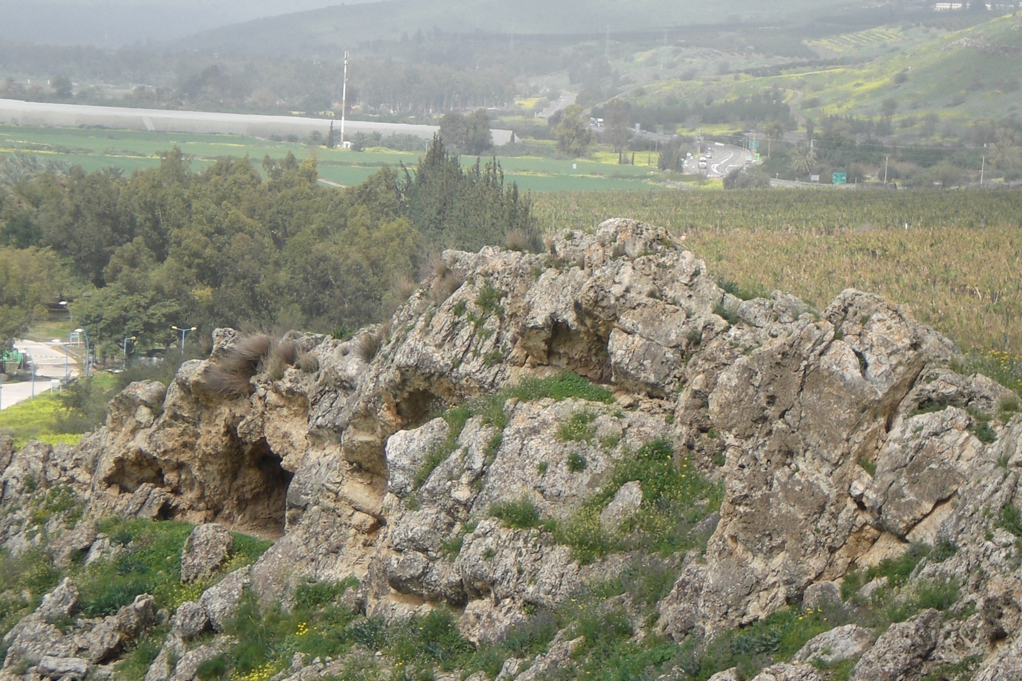
Caves – Possible dwelling place of the Gadarene or Gerasene Demoniac(s) (Mt. 8:28-34)

Slide 31
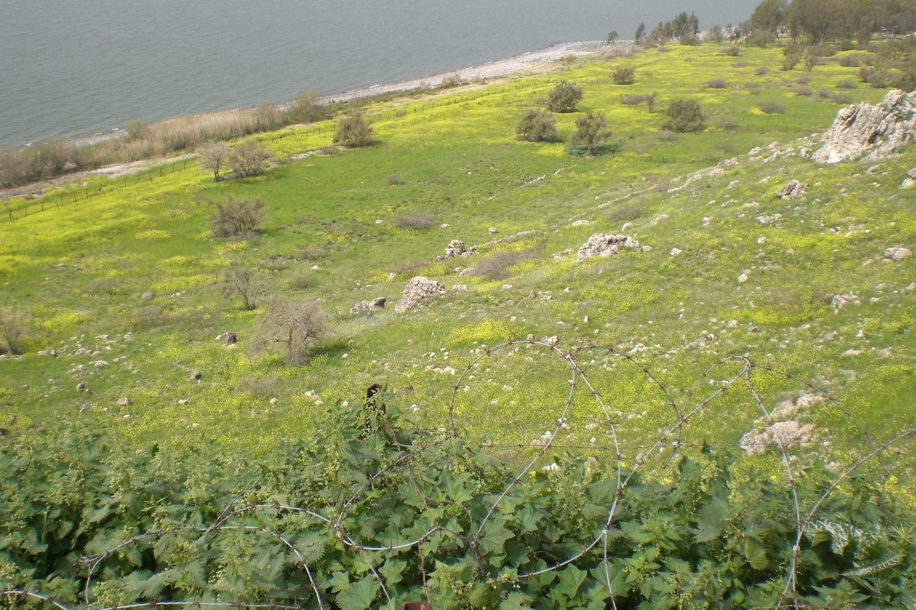
Cliff down which the hogs may have plummeted, soon to plunge to their deaths in the Sea of Galilee

