Slide 1
“Even Godly Men Compromise”
Genesis 20:1-18
Repeating the error of Gen. 12:10-20 (20:1-2).
God warns Abimelech of Sarah’s identity (20:3-8).
Abimelech confronts Abraham who rationalizes his own actions (20:9-13).
After receiving a gift, Abraham prays for Abimelech (20:14-18).
Notes:
Abimelech, like Pharaoh, is a title, not a name.

Slide 2
Repeating the error of Gen. 12:10-20 (20:1-2).
  (vs. 1) The geography of this section is first. The last time we took note of Abraham, he was in “the place where he had stood before the Lord; and he looked down toward Sodom and Gomorrah, and toward all the land of the valley, and he saw, and behold, the smoke of the land ascended like the smoke of a furnace” (Gen. 19:27b-28), the same place where he stood when “the men,” really angels, “turned away from there and went toward Sodom” (Gen. 18:22). It is not stated why “Abraham journeyed from there

Slide 3
  (vs. 1) toward the land of the Negev, and settled between Kadesh and Shur; then he sojourned in Gerar.” Some have suggested that Abraham really did not have direction for this journey from God and that is why he got in trouble for it. But that is conjecture. The term “Negev” means “south country.” Gerar was a town of the Philistines there.
  (vs. 2) So when it says, “Abimelech king of Gerar,” it is equal to “to Abimelech king of the Philistines,” acc. to Gen. 26:1b, where Isaac repeated Abraham’s sin (Gen. 26:7). It is not surprising that Abimelech

Slide 4
  (cont.) “king of Gerar sent and took Sarah.”

Slide 5
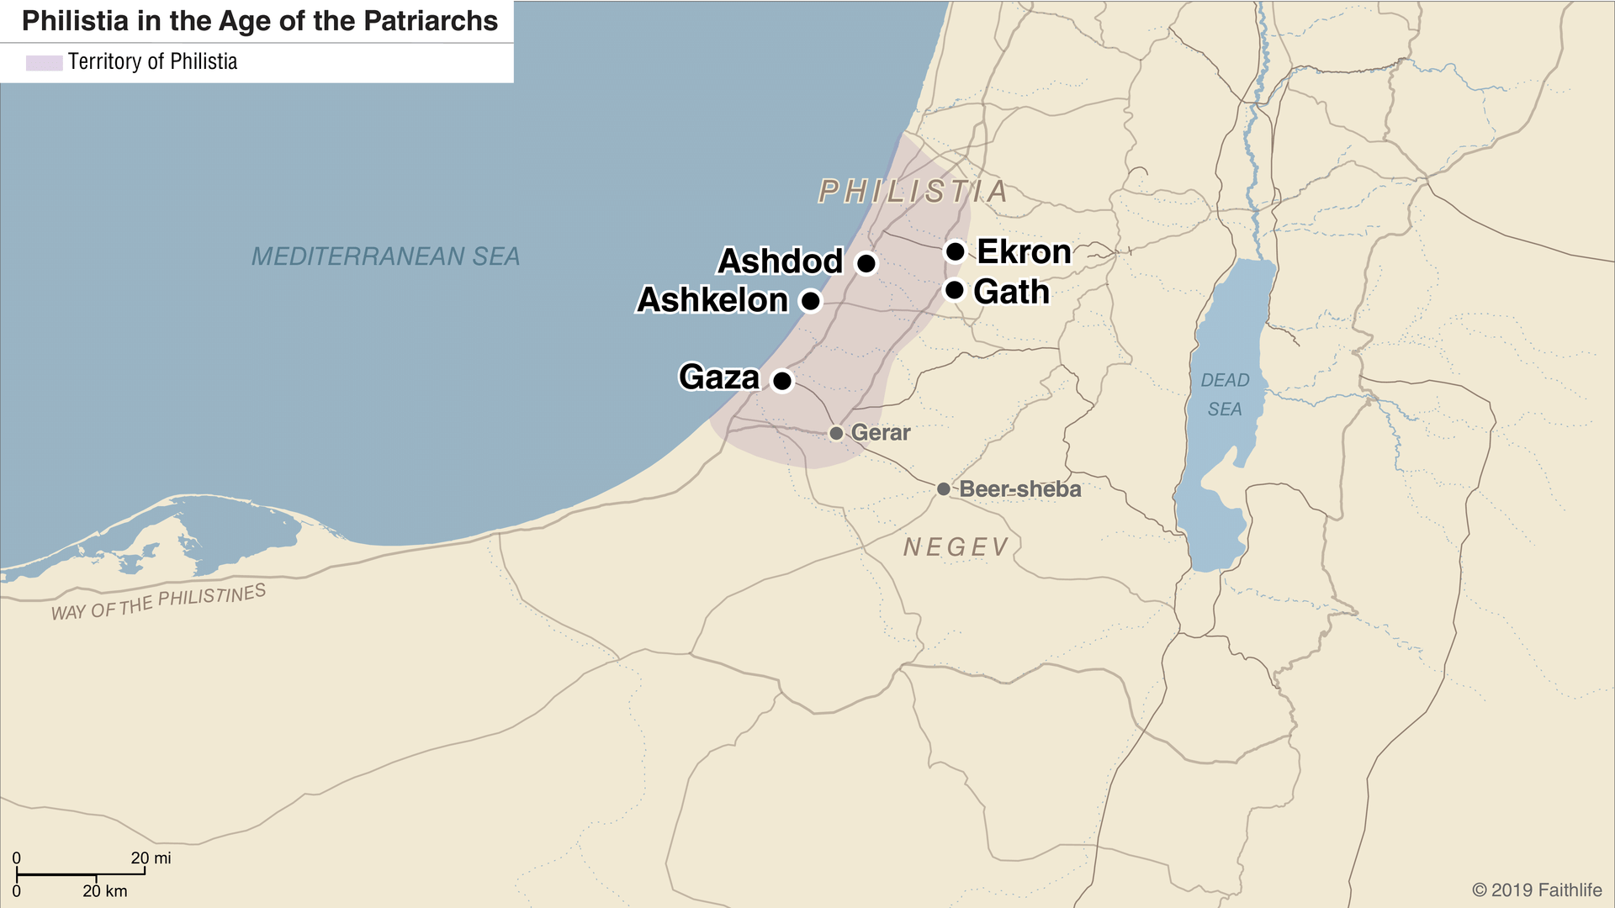

Slide 6
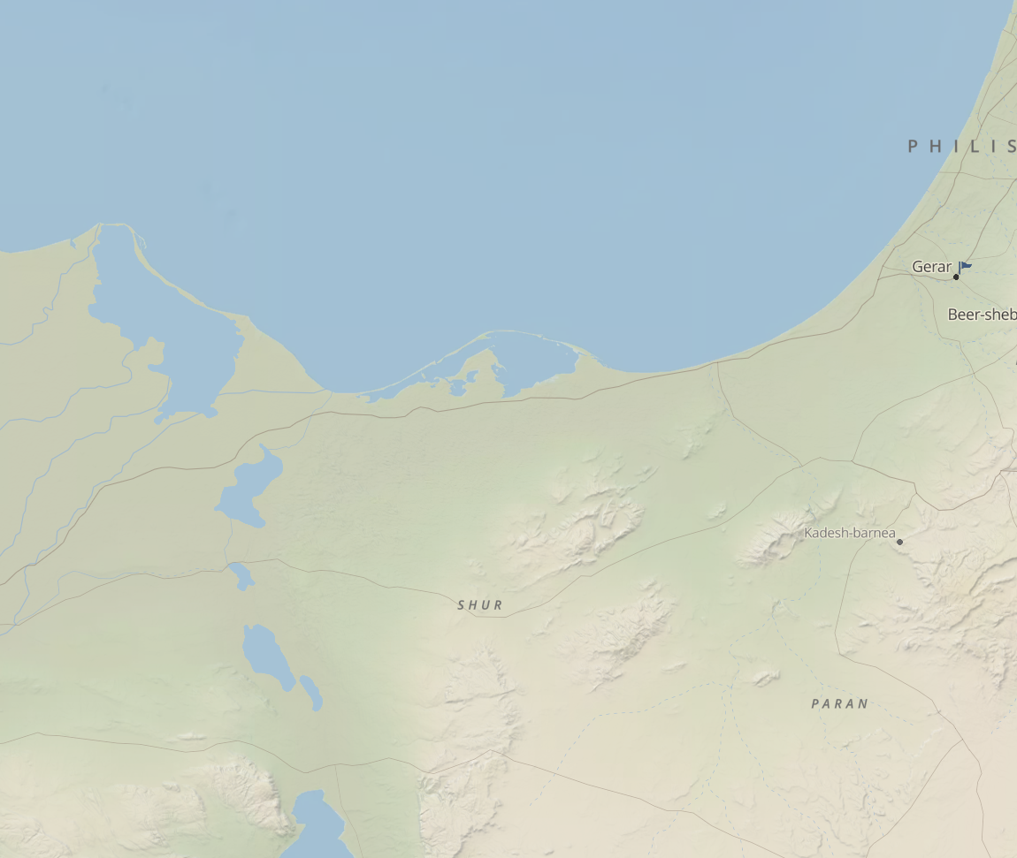

Slide 7
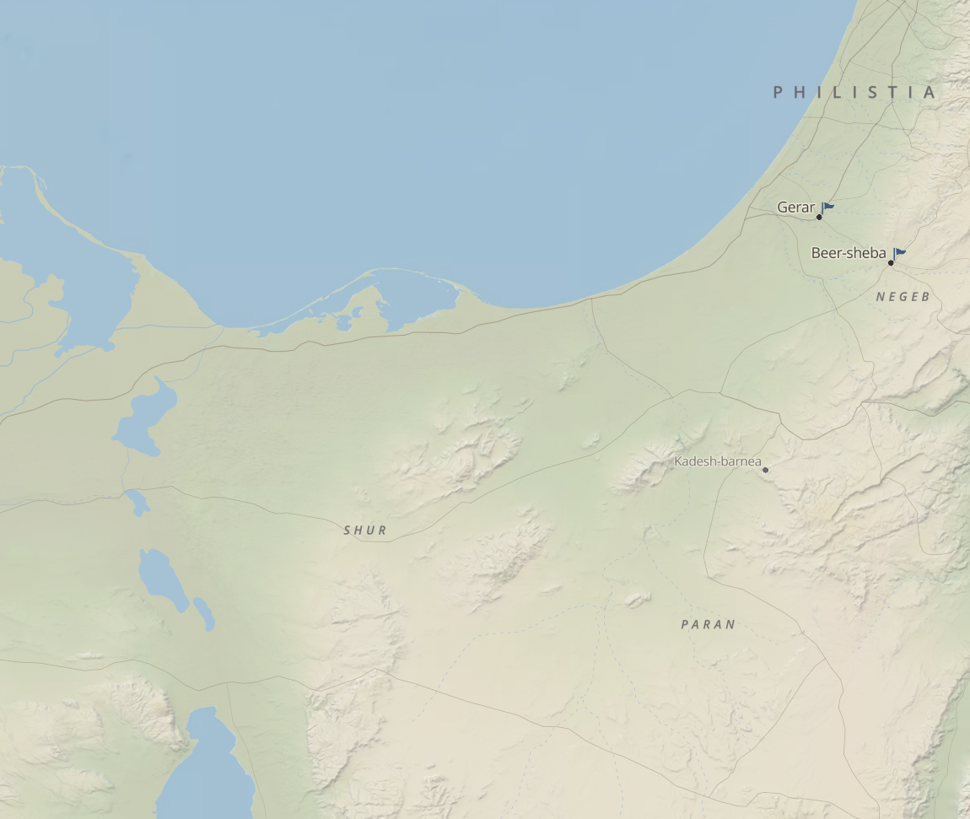

Slide 8
God warns Abimelech of Sarah’s identity (20:3-8).
  (vs. 3) Though Abimelech had taken Sarah “in good faith,” as we might say, God had a surprise for him in the night. “God came to Abimelech in a dream of the night, and said to him, ‘Behold, you are a dead man because of the woman whom you have taken, for she is married.’” In his innocence, Abimelech had committed a sin, namely, adultery, worthy of death. He was as good as dead as far as God was concerned.
  (vs. 4) Abimelech’s defense: “Lord, will You slay a nation, even though blameless?” BK notes, “There is
Notes:
Allen P. Ross, “Genesis,” in The Bible Knowledge Commentary: An Exposition of the Scriptures, ed. J. F. Walvoord and R. B. Zuck, vol. 1 (Wheaton, IL: Victor Books, 1985), 62.

Slide 9
  (cont.) a fitting wordplay here. Abraham had prayed that the righteous would not be destroyed with the wicked (18:23-32). Now Abimelech’s words echoed the same concern: Lord, will You destroy an innocent nation? The rebuke of this expression would have been forceful for Abraham.”
  (vs. 5) Abimelech reinforces his defense here: “Did he not himself say to me, ‘She is my sister’? And she herself said, ‘He is my brother.’ In the integrity of my heart and the innocence of my hands I have done this.” “Innocence” is “moral impeccability as a
Notes:
Allen P. Ross, “Genesis,” in The Bible Knowledge Commentary: An Exposition of the Scriptures, ed. J. F. Walvoord and R. B. Zuck, vol. 1 (Wheaton, IL: Victor Books, 1985), 62.
James Swanson, Dictionary of Biblical Languages with Semantic Domains : Hebrew (Old Testament) (Oak Harbor: Logos Research Systems, Inc., 1997).

Slide 10
  (cont.) figurative extension of washed hands with no dirt on them.”
  (vs. 6) The communication continued in the dream as God conceded, “Yes, I know that in the integrity of your heart you have done this, and I also kept you from sinning against Me; therefore I did not let you touch her.” The fact of the matter was that God had supernaturally intervened to prevent Abimelech from getting sexually involved with Sarah. He had to do it because it would have threatened the whole redemptive plan of God. Not happening!
Notes:
Allen P. Ross, “Genesis,” in The Bible Knowledge Commentary: An Exposition of the Scriptures, ed. J. F. Walvoord and R. B. Zuck, vol. 1 (Wheaton, IL: Victor Books, 1985), 62.
James Swanson, Dictionary of Biblical Languages with Semantic Domains : Hebrew (Old Testament) (Oak Harbor: Logos Research Systems, Inc., 1997).

Slide 11
  (vs. 7) God had Abimelech’s undivided attention, so He continued: “Now therefore, restore the man’s wife, for he is a prophet, and he will pray for you and you will live. But if you do not restore her, know that you shall surely die, you and all who are yours.” This is the first use of the term “prophet (נָבִ֣יא – nābîʾ)” in the Bible. The context is obviously one of a man who speaks with authority for God, even having the power of life and death. So if Abimelech obeys and restores Sarah, and Abraham prays for him, Abimelech will live. But if otherwise, “know that you shall surely
Notes:
Allen P. Ross, “Genesis,” in The Bible Knowledge Commentary: An Exposition of the Scriptures, ed. J. F. Walvoord and R. B. Zuck, vol. 1 (Wheaton, IL: Victor Books, 1985), 62.
James Swanson, Dictionary of Biblical Languages with Semantic Domains : Hebrew (Old Testament) (Oak Harbor: Logos Research Systems, Inc., 1997).

Slide 12
  (cont.) die, you and all who are yours,” that is, everyone in your family. This is like the judgment on Korah (Num. 16:32-35) and Achan (Josh. 7:24-26).
  (vs. 8) “So Abimelech arose early in the morning and called all his servants and told all these things in their hearing; and the men were greatly frightened.” He clearly wanted all of his people to be informed of the danger and willing to take whatever action to get the situation corrected.
Notes:
Allen P. Ross, “Genesis,” in The Bible Knowledge Commentary: An Exposition of the Scriptures, ed. J. F. Walvoord and R. B. Zuck, vol. 1 (Wheaton, IL: Victor Books, 1985), 62.
James Swanson, Dictionary of Biblical Languages with Semantic Domains : Hebrew (Old Testament) (Oak Harbor: Logos Research Systems, Inc., 1997).

Slide 13
Abimelech confronts Abraham who rationalizes his own actions (20:9-13).
  (vs. 9) The pagan king Abimelech realizes how he got into this bind. It was Abraham. So, he rightly confronted him asking, “What have you done to us?” That is, how did you get me into this mess where God was threatening to take the lives of me and my family? “And how have I sinned against you, that you have brought on me and on my kingdom a great sin?” Abraham, how did we come to deserve to be entrapped into committing a great sin?
Notes:
Abimelech, like Pharaoh, is a title, not a name.

Slide 14
  (conc.) His conclusion was; “You have done to me things that ought not to be done.” Abraham was wrong!
  (vs. 10) Abimelech was thinking that there must be some ostensible reason for this in Abraham’s mind. So, he confronted him with this question: “What have you encountered, that you have done this thing?”
  (vs. 11) Abraham was honest. What else could he say? His answer: “Because I thought, surely there is no fear of God in this place, and they will kill me because of my wife.” So, Abraham contrived the scheme to save his own neck.
Notes:
Abimelech, like Pharaoh, is a title, not a name.

Slide 15
  (vs. 12) Let the rationalizing begin! Abraham said, “Besides, she actually (ʾām·nā(h)) is my sister, the daughter of my father, but not the daughter of my mother, and she became my wife.” Abraham is saying that everything I’ve said is true, Sarah is both my wife and my sister. But he was trying to deceive Abimelech into believing that Sarah was his sister only. That was a half-truth and as one of my instructors once said, “A half-truth is no truth at all.” The statement was designed to cause Abimelech to believe a whole lie.
Notes:
Abimelech, like Pharaoh, is a title, not a name.
To rationalize is to “attempt to justify (an action or attitude) with logical reasoning.”
Concise Oxford English Dictionary (Oxford: Oxford University Press, 2004).

Slide 16
  (vs. 13) Abraham came to realize that it is a dangerous world out there. So, he tried to find a way to make it safe for himself: “and it came about, when God caused me to wander from my father’s house, that I said to her, Sarah, ‘This is the kindness which you will show to me: everywhere we go, say of me, “He is my brother.”’” So, for safety’s sake, Abraham’s own safety, that is, Abraham and Sarah had a prearranged plan: “This is the kindness which you will show to me: everywhere we go, say of me, ‘He is my brother.’” No threats came fr. Abimelech!
Notes:
Abimelech, like Pharaoh, is a title, not a name.
To rationalize is to “attempt to justify (an action or attitude) with logical reasoning.”
Concise Oxford English Dictionary (Oxford: Oxford University Press, 2004).

Slide 17
After receiving a gift, Abraham prayed for Abimelech (20:14-18).
  (vs. 14) Perhaps Abraham’s explanation seemed plausible to Abimelech, i.e., “I can understand that.” So, he offered gifts to Abraham and seemed ready to move on: “Abimelech then took sheep and oxen and male and female servants, and gave them to Abraham, and restored his wife Sarah to him.”
  (vs. 15) He was even more generous than that. Like Pharoah later on (Gen. 47:5-6), he said. “Behold, my land is before you; settle wherever you please.”
Notes:
Abimelech, like Pharaoh, is a title, not a name.

Slide 18
  (vs. 16) He informed Sarah of his kindnesses to Abraham: “Behold, I have given your brother a thousand pieces of silver; behold, it is your vindication before all who are with you, and before all men you are cleared.” The KJV translation is not good here: “Behold, I have given thy brother a thousand pieces of silver: behold, he is to thee a covering of the eyes, unto all that are with thee, and with all other: thus, she was reproved.”
  (vs. 17) God had told Abimelech in vs. 7, “Now therefore, restore the man’s wife, for he is a prophet,
Notes:
Abimelech, like Pharaoh, is a title, not a name.

Slide 19
  (cont.) and he will pray for you and you will live.” And it came to pass: “Abraham prayed to God, and God healed Abimelech and his wife and his maids, so that they bore children.” The women needed healing because they had all been struck with barrenness on account of Abimelech’s error of taking Sarah.
  (vs. 18) This verse is the simple explanation for why healing was needed for Abimelech’s household. “For the Lord had closed fast all the wombs of the household of Abimelech because of Sarah, Abraham’s wife.”
Notes:
Abimelech, like Pharaoh, is a title, not a name.
TC says, “’Abimelech’ was a title rather than a proper name (cf. 26:1; Judg. 8:31; 2 Sam. 11:21; Ps. 34 title). It meant “royal father” or “the king [Milku, a Canaanite deity mentioned in the Amarna letters] is my father.”
Tom Constable, (Galaxie Software, 2003), Ge 20:1.

