Slide 1


Slide 2
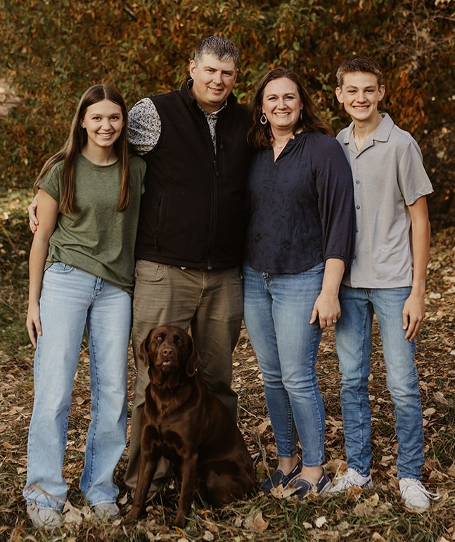

Rusty & Lacey Gulbranson
Jasper,and Jade
God has called me to serve Him to provide resources, pray and build relationships to secure foundations to disciple children for generations to come.
Matthew 19:14 Jesus said, “Let the little children come to me, and do not hinder them, for the kingdom of heaven belongs to such as these.

Slide 3
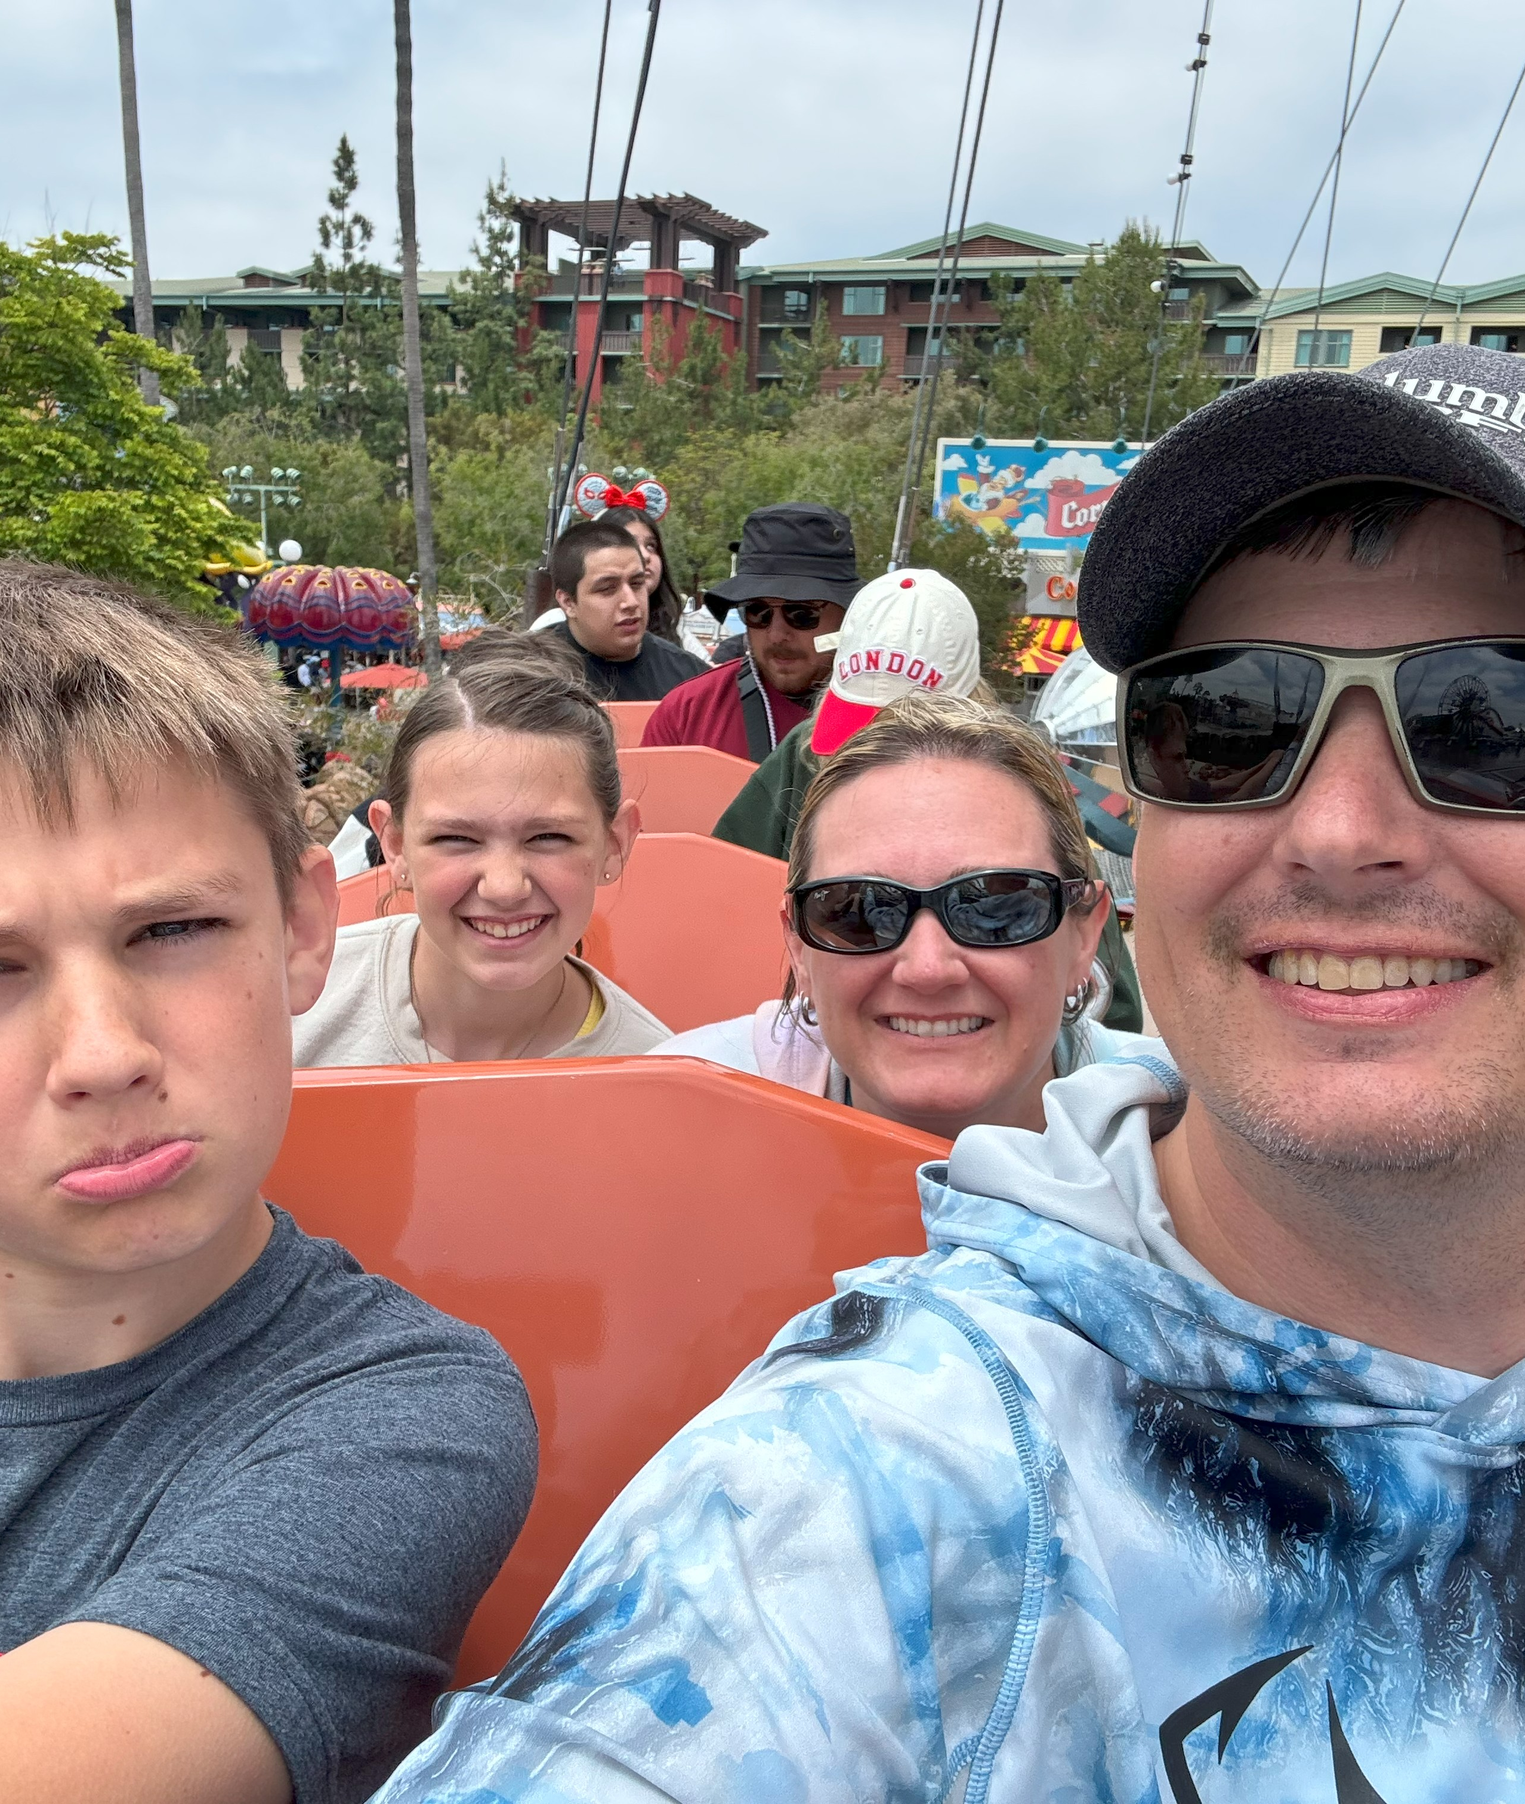
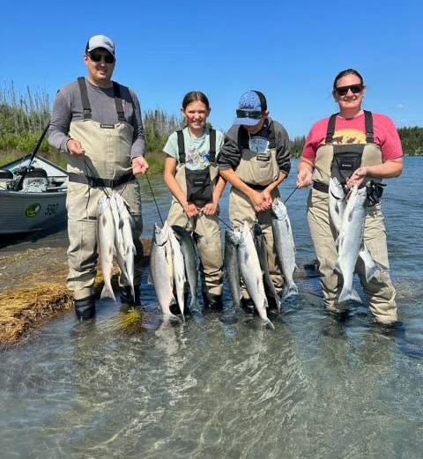

Slide 4
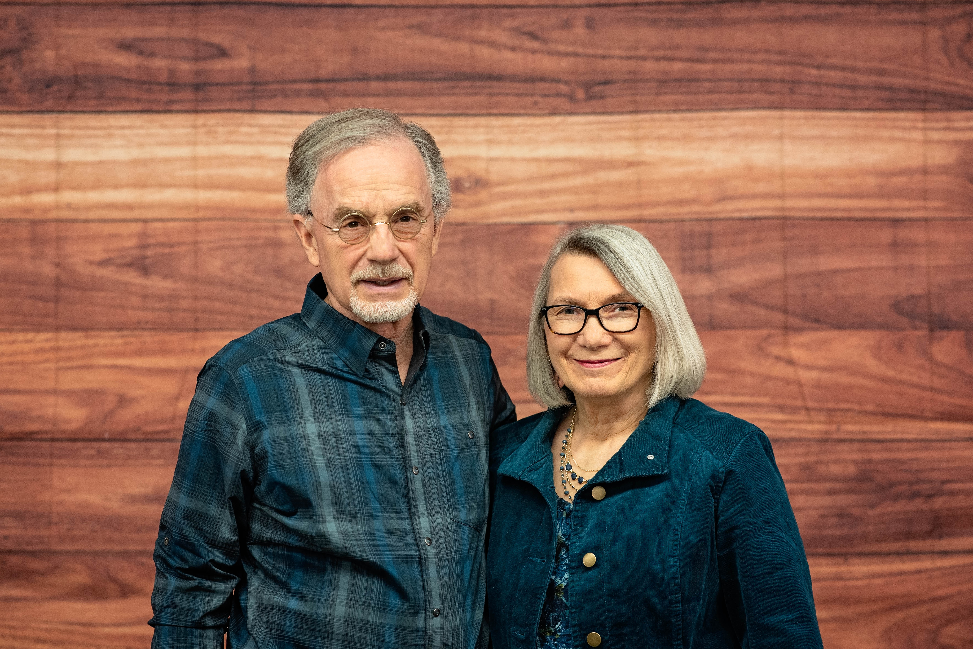
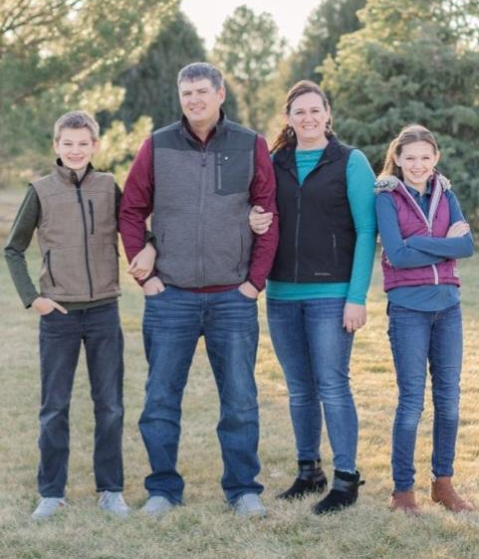
Rick & Fairy Hattan
Serving Awana clubs and churches in Nebraska and Southeast Wyoming for 40 years! Impacting generations of Christ followers seeing that Kids come to know, love, and serve God!
Luke 24:32 They asked each other, “Were not our hearts burning within us while he talked with us on the road and opened the scriptures to us?”

Slide 5
Reach
Kids
Equip
Leaders
Change
the World

Slide 6
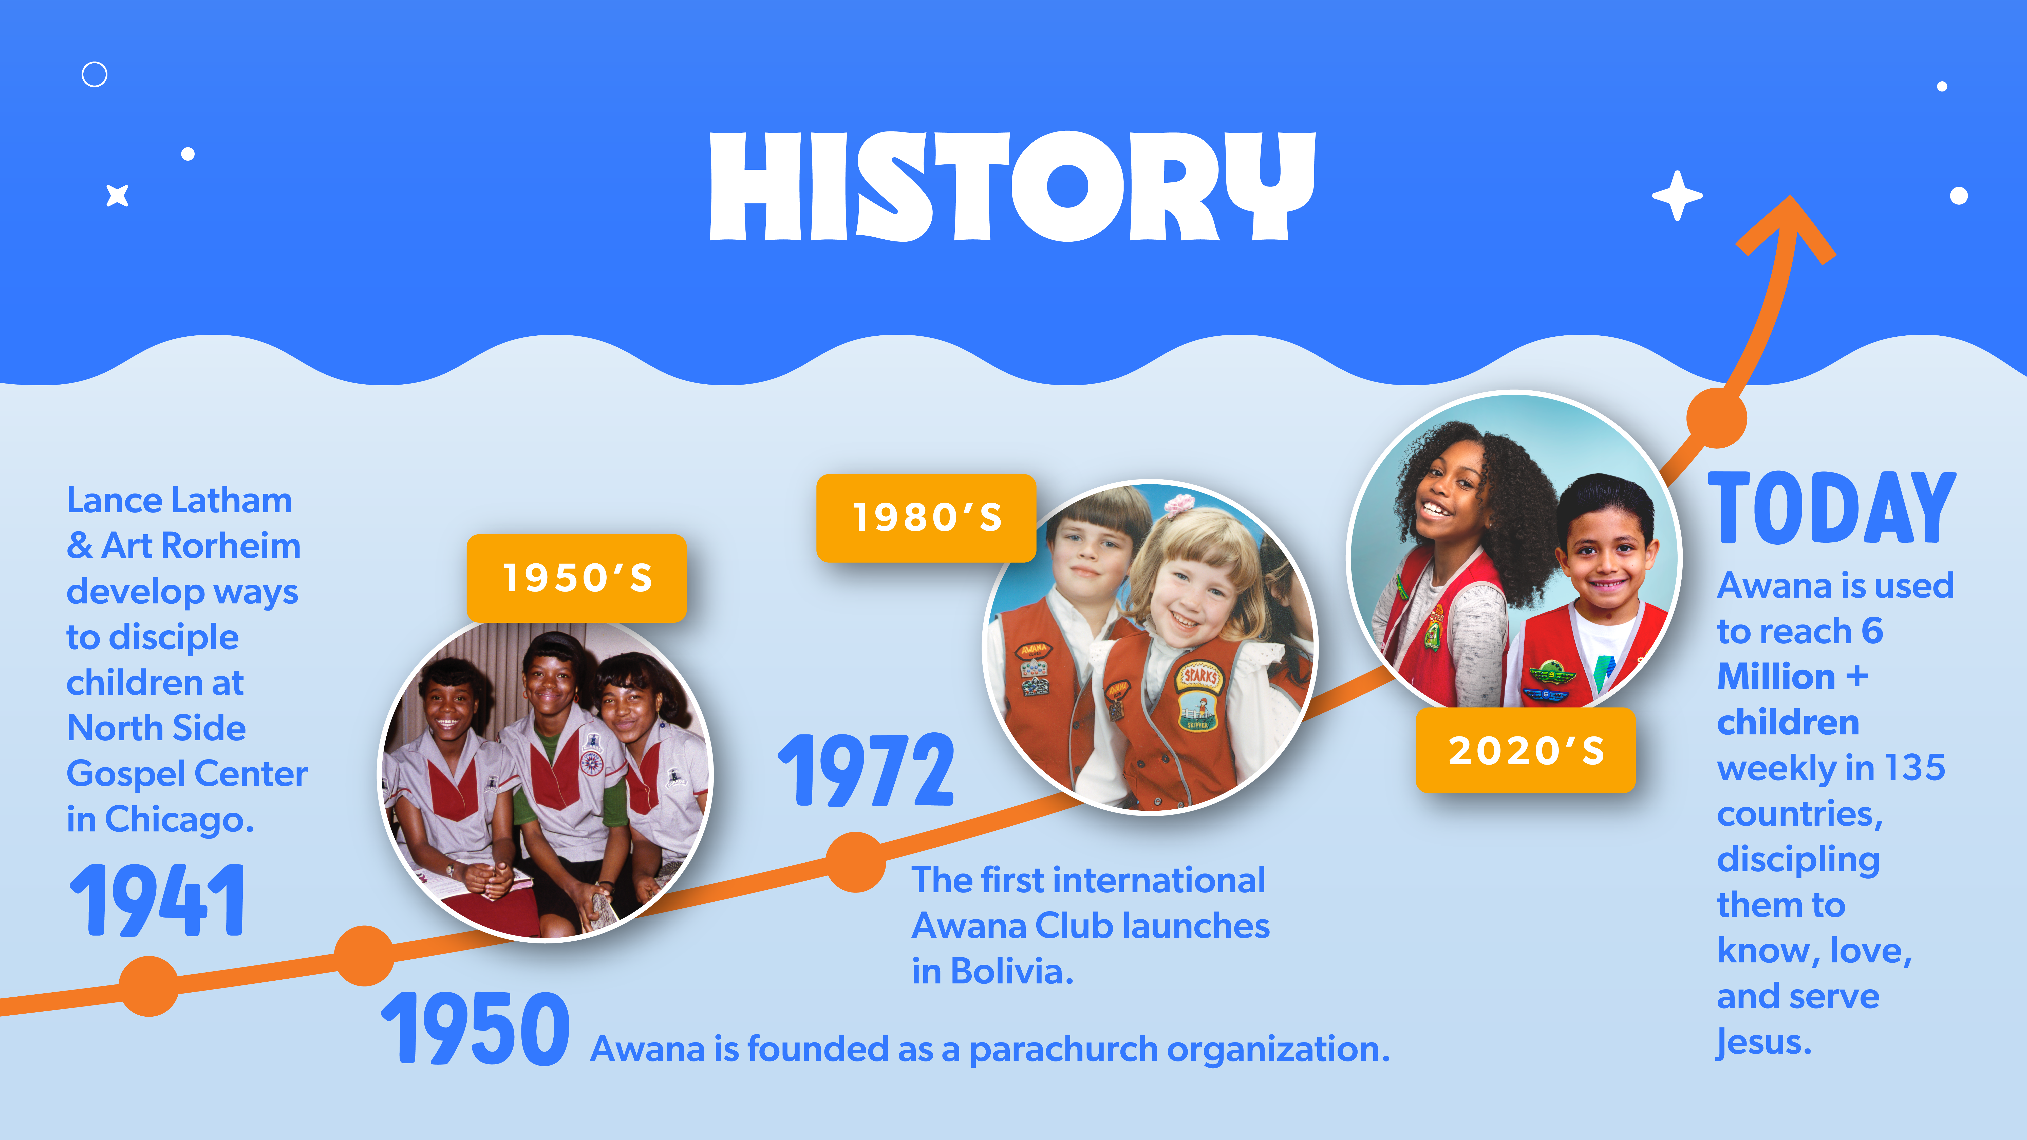

Slide 7
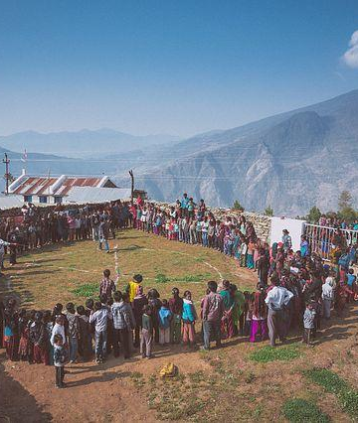
Discipling kids in 140 countries
Reaching 10 million children worldwide with the Gospel
Based upon current stats

Slide 8

The vision and prayer of Awana is that all children and youth throughout the world will come to know, love, and serve the Lord Jesus Christ.
Our Vision and Prayer

Slide 9

The mission of Awana is to equip leaders to reach kids with the gospel and engage them in lifelong discipleship.
Our Mission

Slide 10
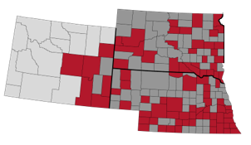
Nebraska, South Dakota and
SE Wyoming
In our area there are 140 Awana clubs but there are still many counties that do not have Awana and some without childrens ministry of any kind.

Slide 11
Who am I?
Who is God?
What does God want to do through me?

Slide 12

What is causing our kids and youth to turn and run or turn to truth?
Increasing Prevalence of Potentially Traumatic Events
Decreasing Resilience
False Narratives
Influence from friends

Slide 13


Slide 14

When all is lost Jesus is the hope of the world!

